Slide 1
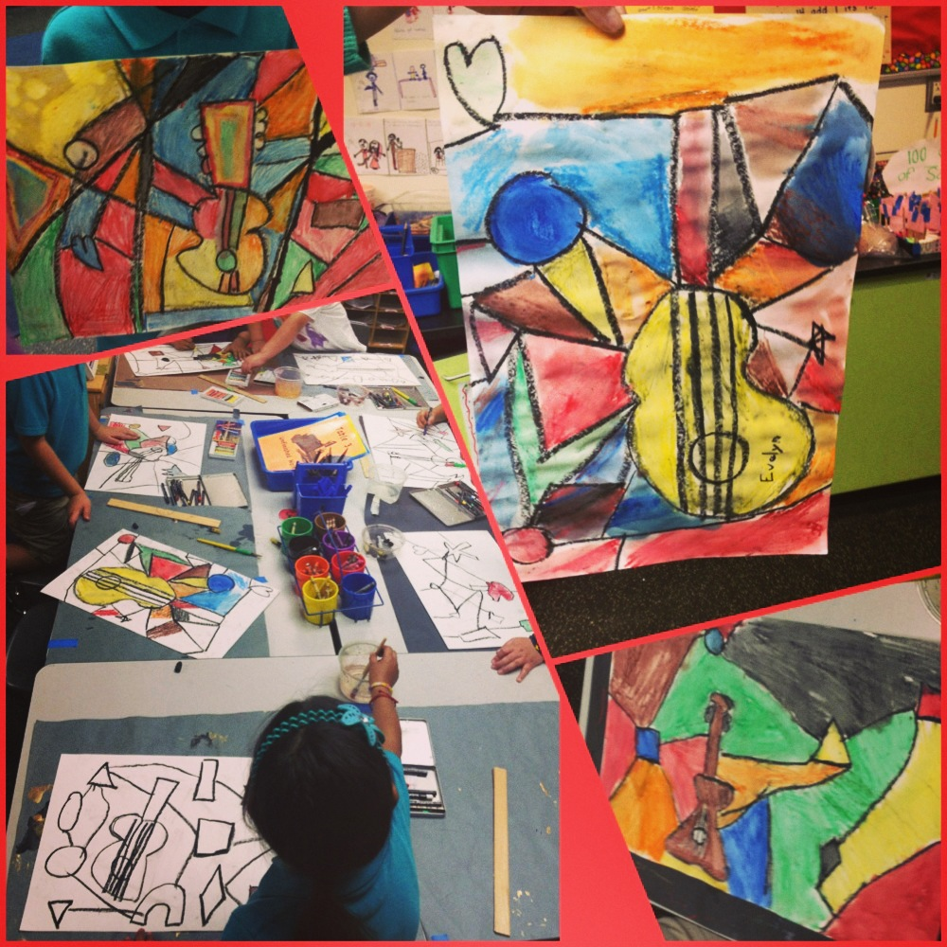

Pablo Picasso Art Lesson
By Ms. Tiffanie Schang
Introduce Pablo Picasso. Define the word “abstract”. Show examples of his abstract paintings. Talk about the colors, shapes…etc
When he was sad, he painted in blue. Talk about how painting can convey feelings. Show blue period paintings.
Talk about how he really liked guitars. Show how he depicted guitars in his paintings.
Task: draw a guitar then add shapes and lines cutting the paper in the background. Color in each shape. Make sure no 2 colors are touching.
Hope you enjoy my art lesson along with the PowerPoint!

Slide 2

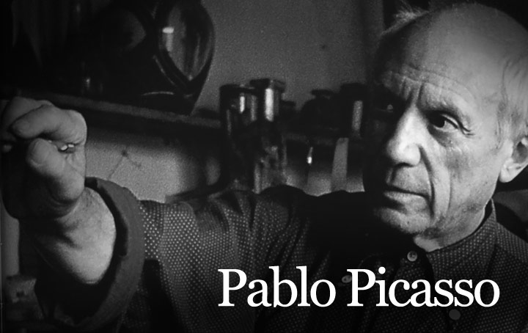
Abstract

Slide 3
Abstract

Slide 4
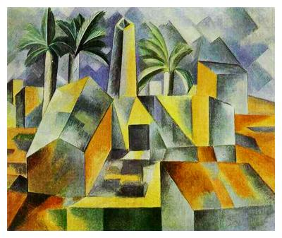

Slide 5
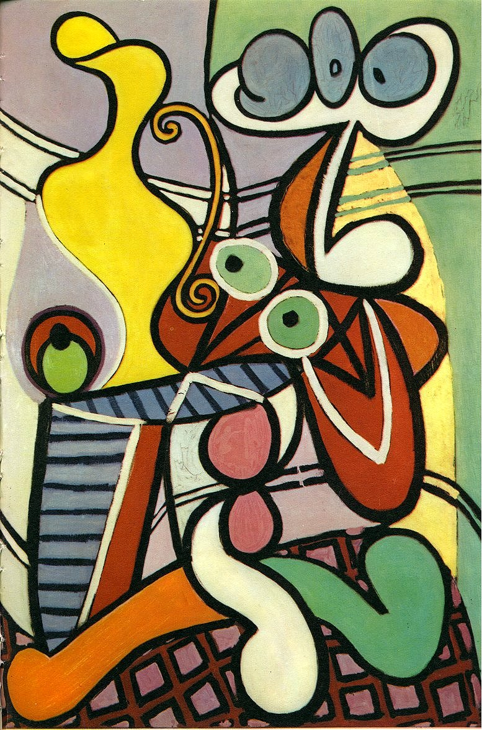

Slide 6
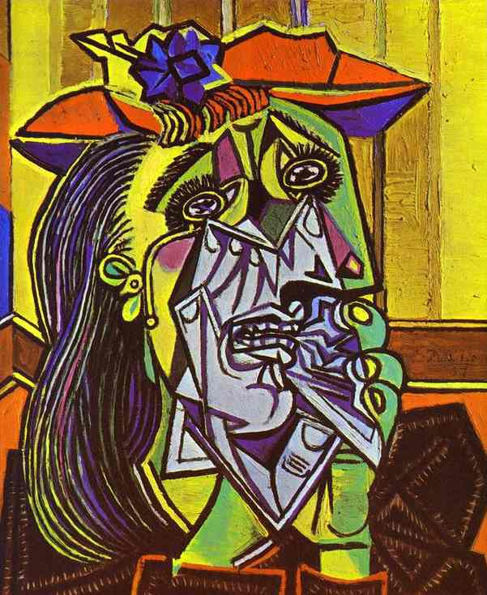

Slide 7
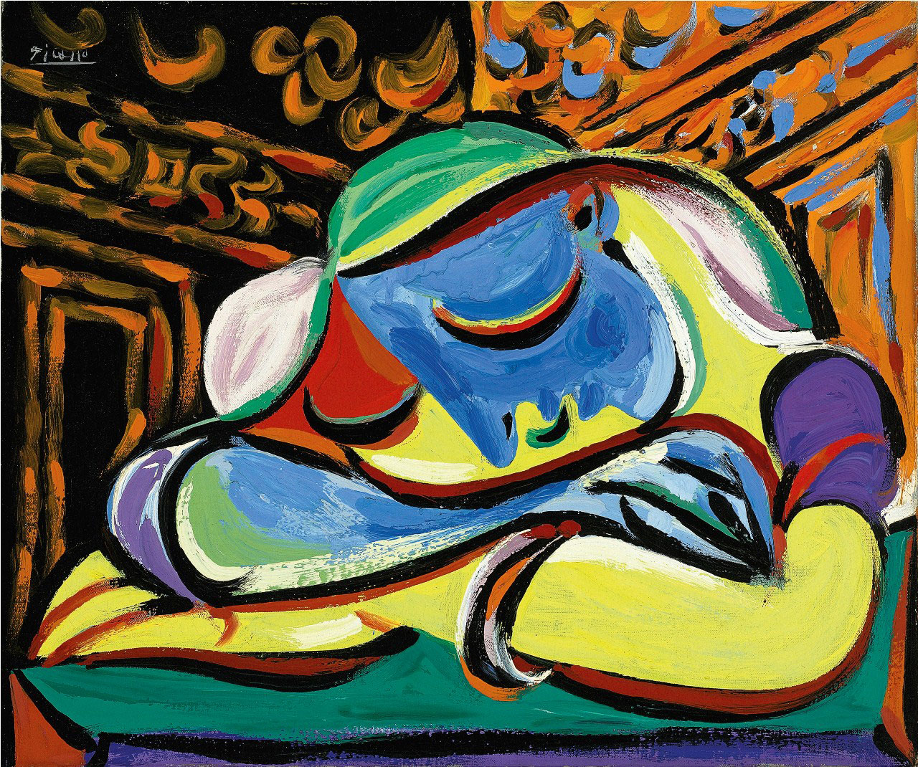

Slide 8
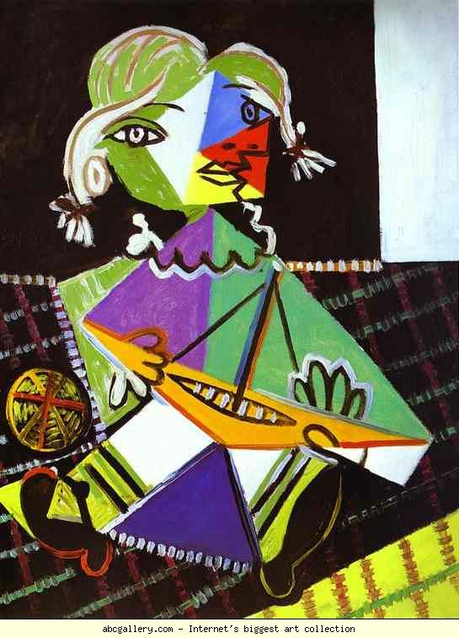

Slide 9
Blue

Slide 10
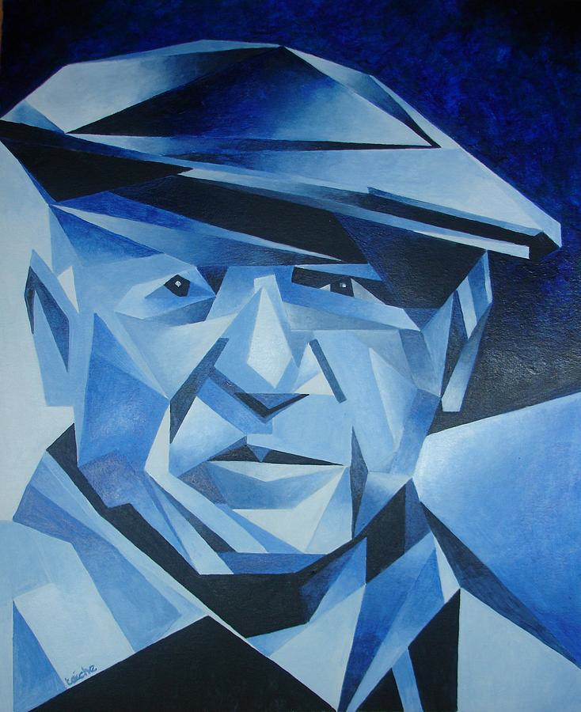

Slide 11
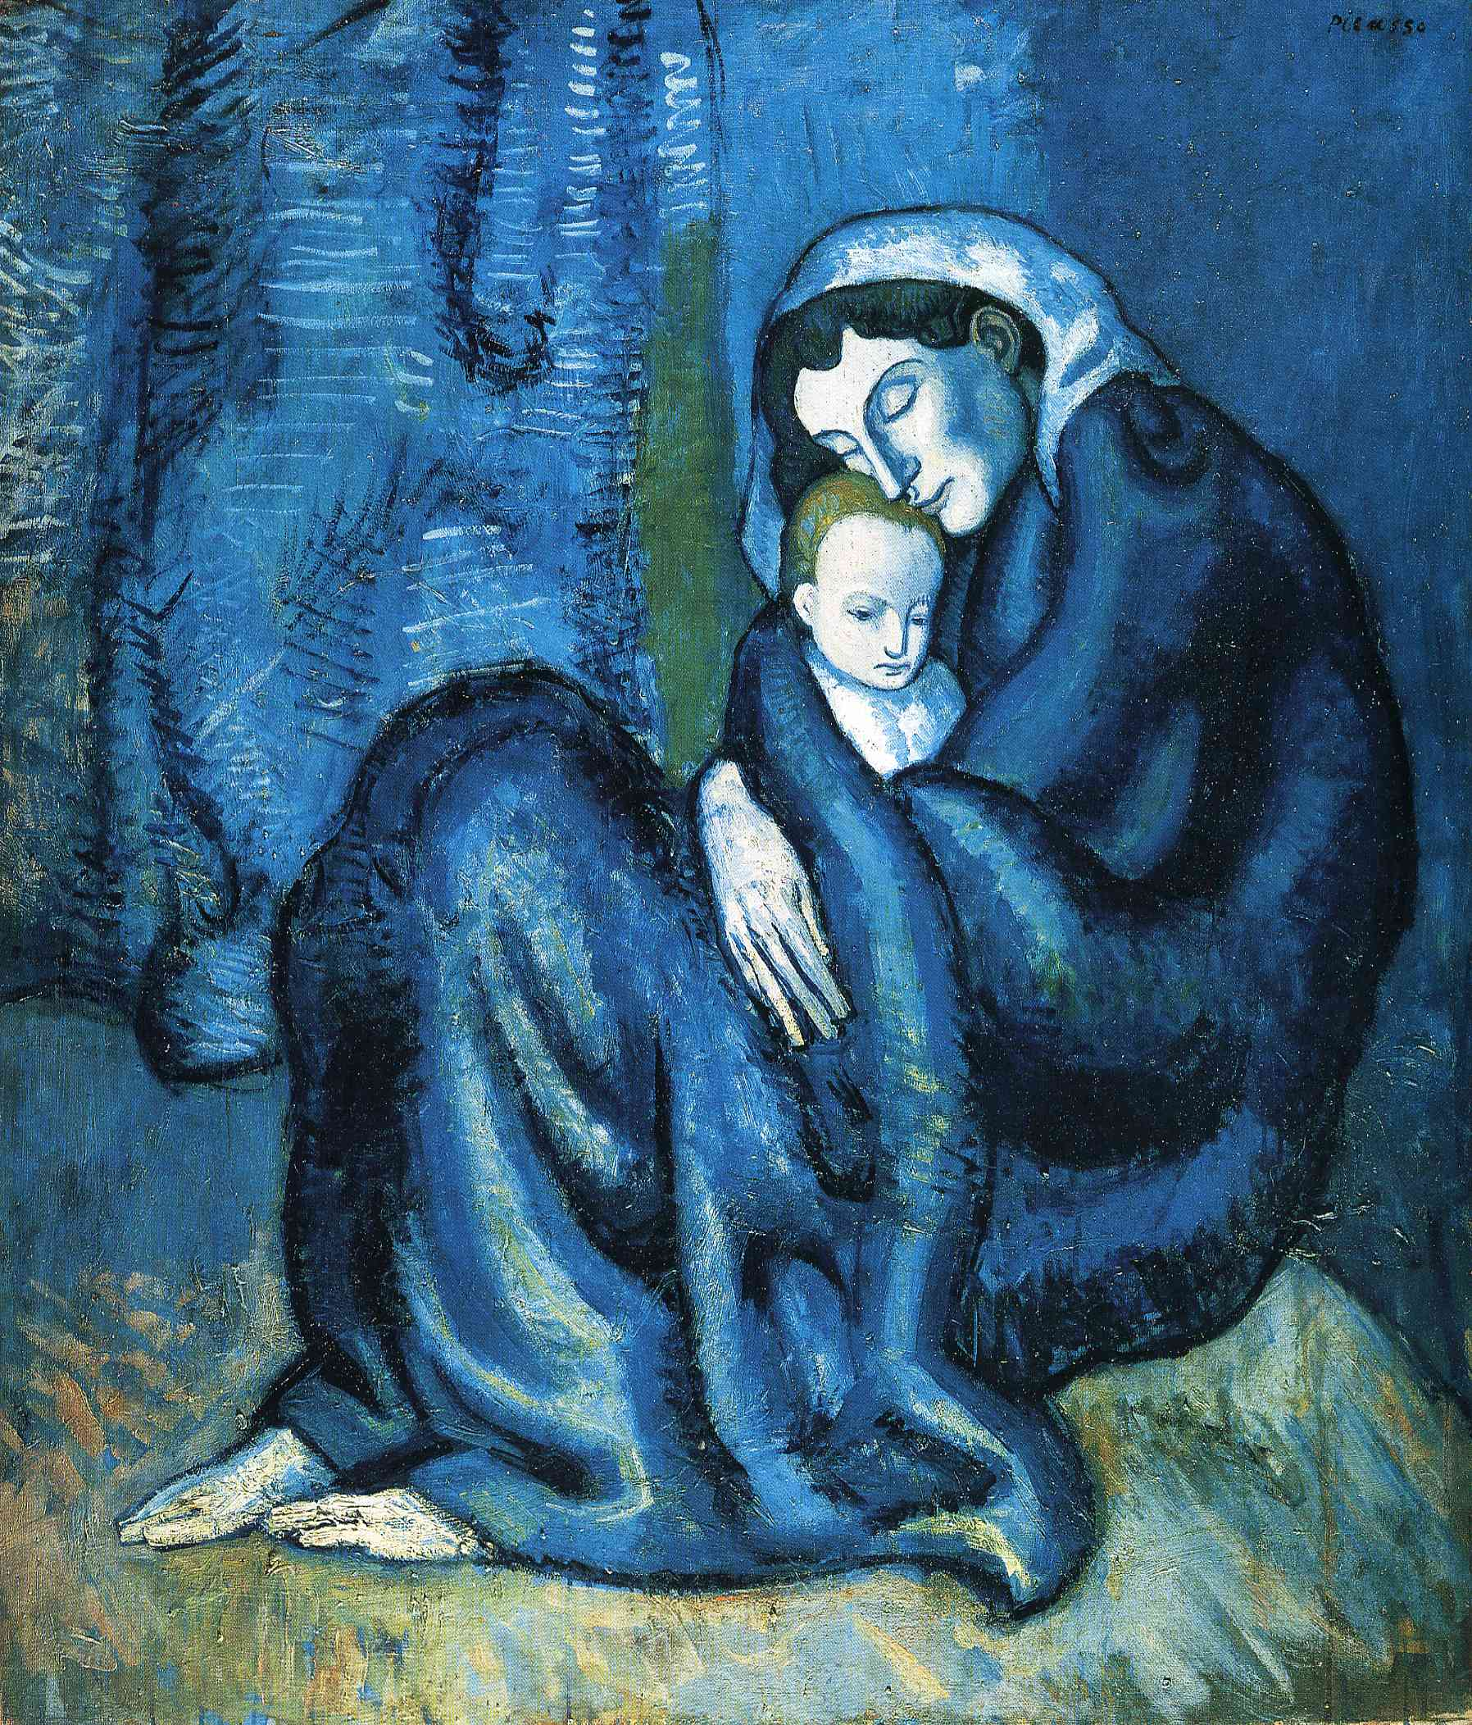

Slide 12
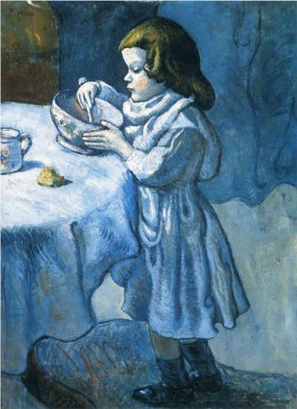

Slide 13
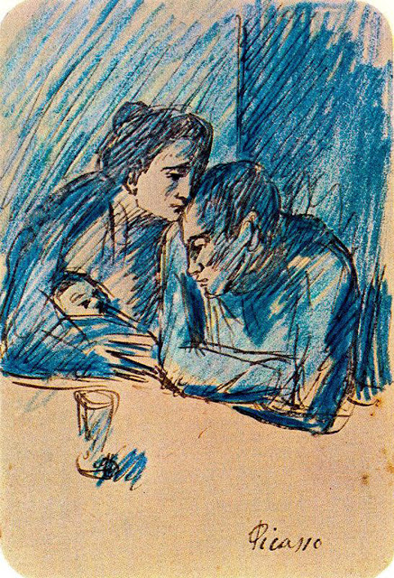

Slide 14
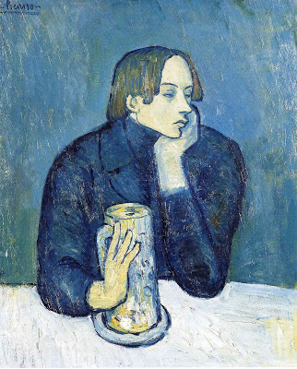

Slide 15
Guitar

Slide 16
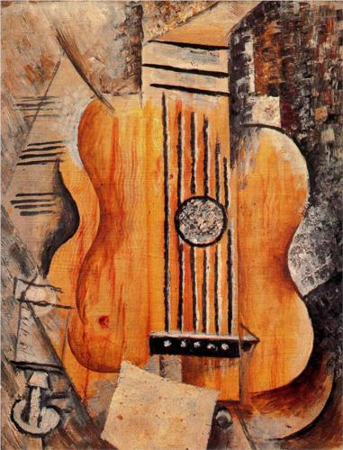

Slide 17
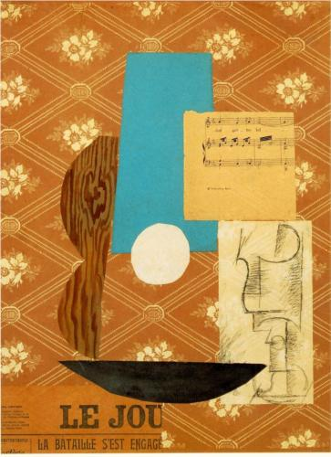

Slide 18
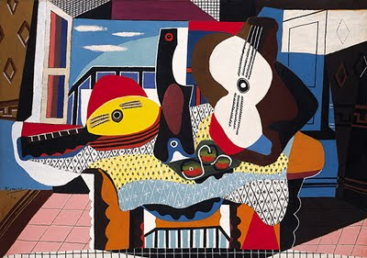

Slide 19
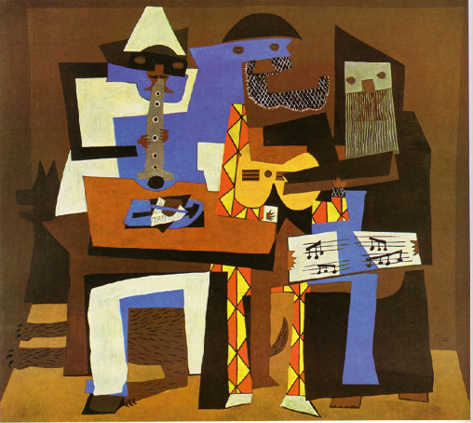

Slide 20
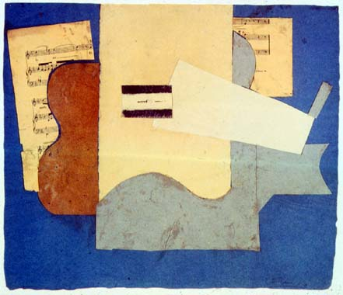

Slide 21
Let’s be Picasso!

